Slide 1


Kubernetes Training

Slide 2

WELCOME

Slide 3
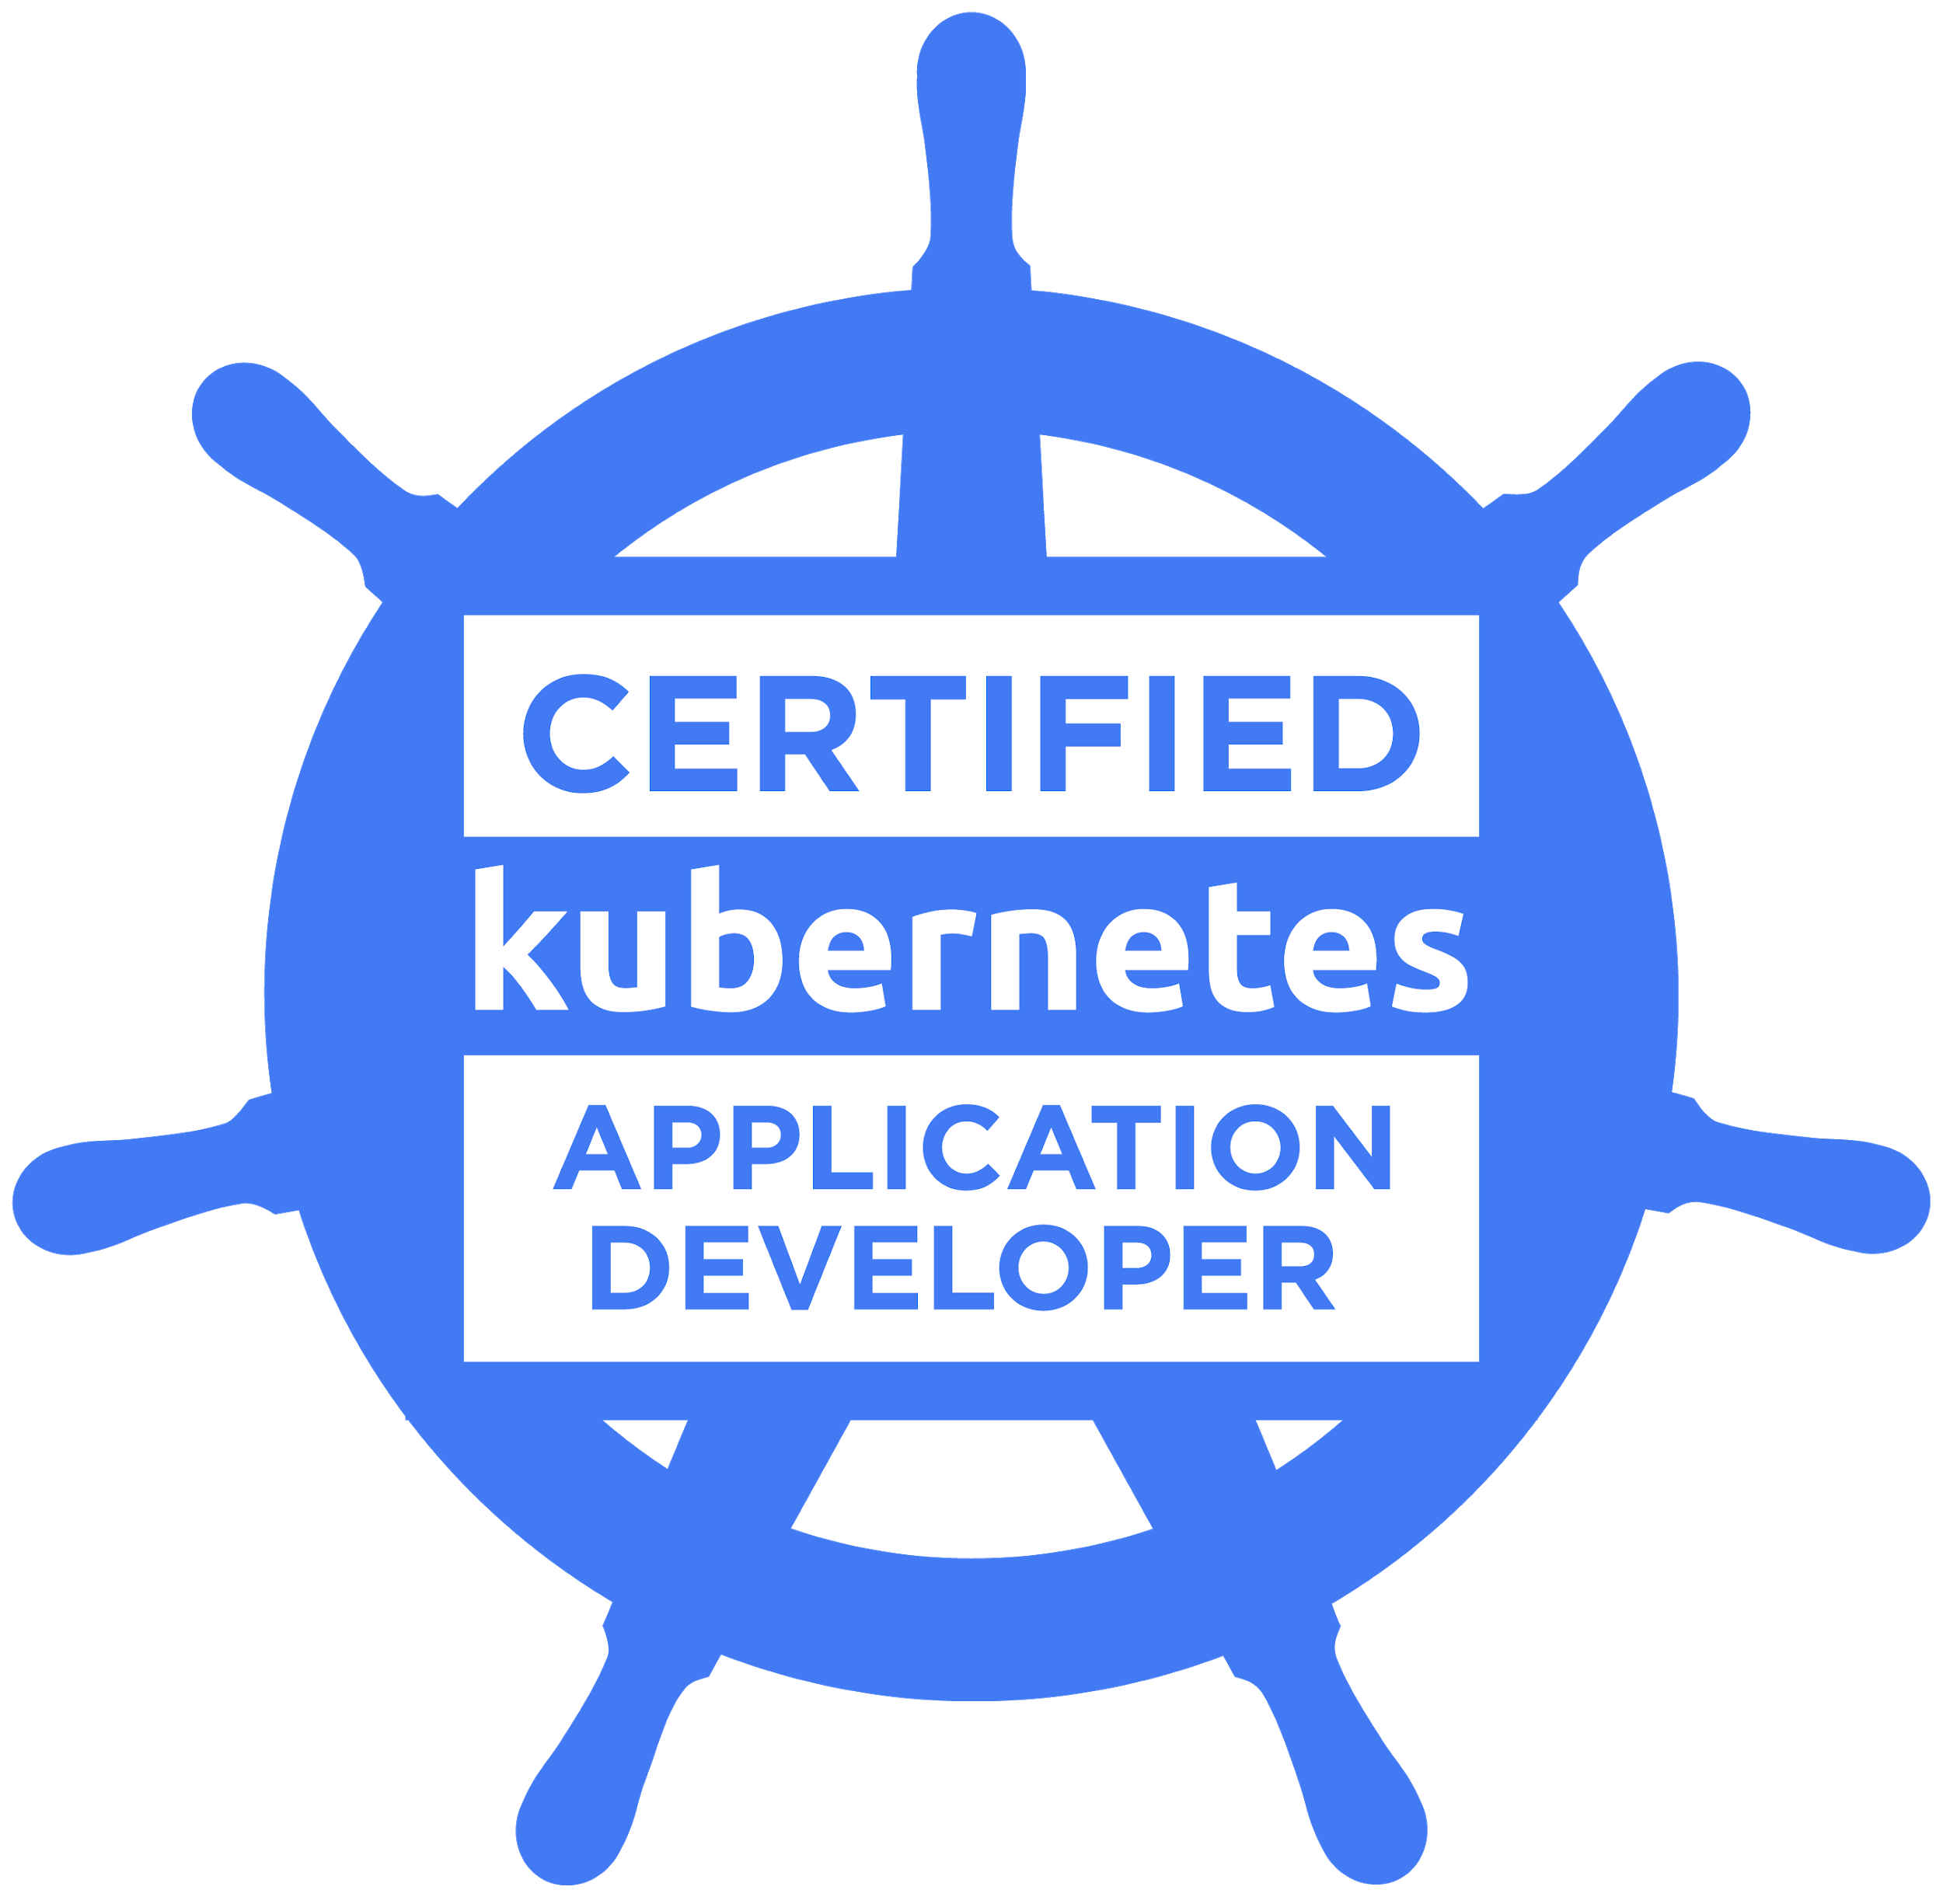
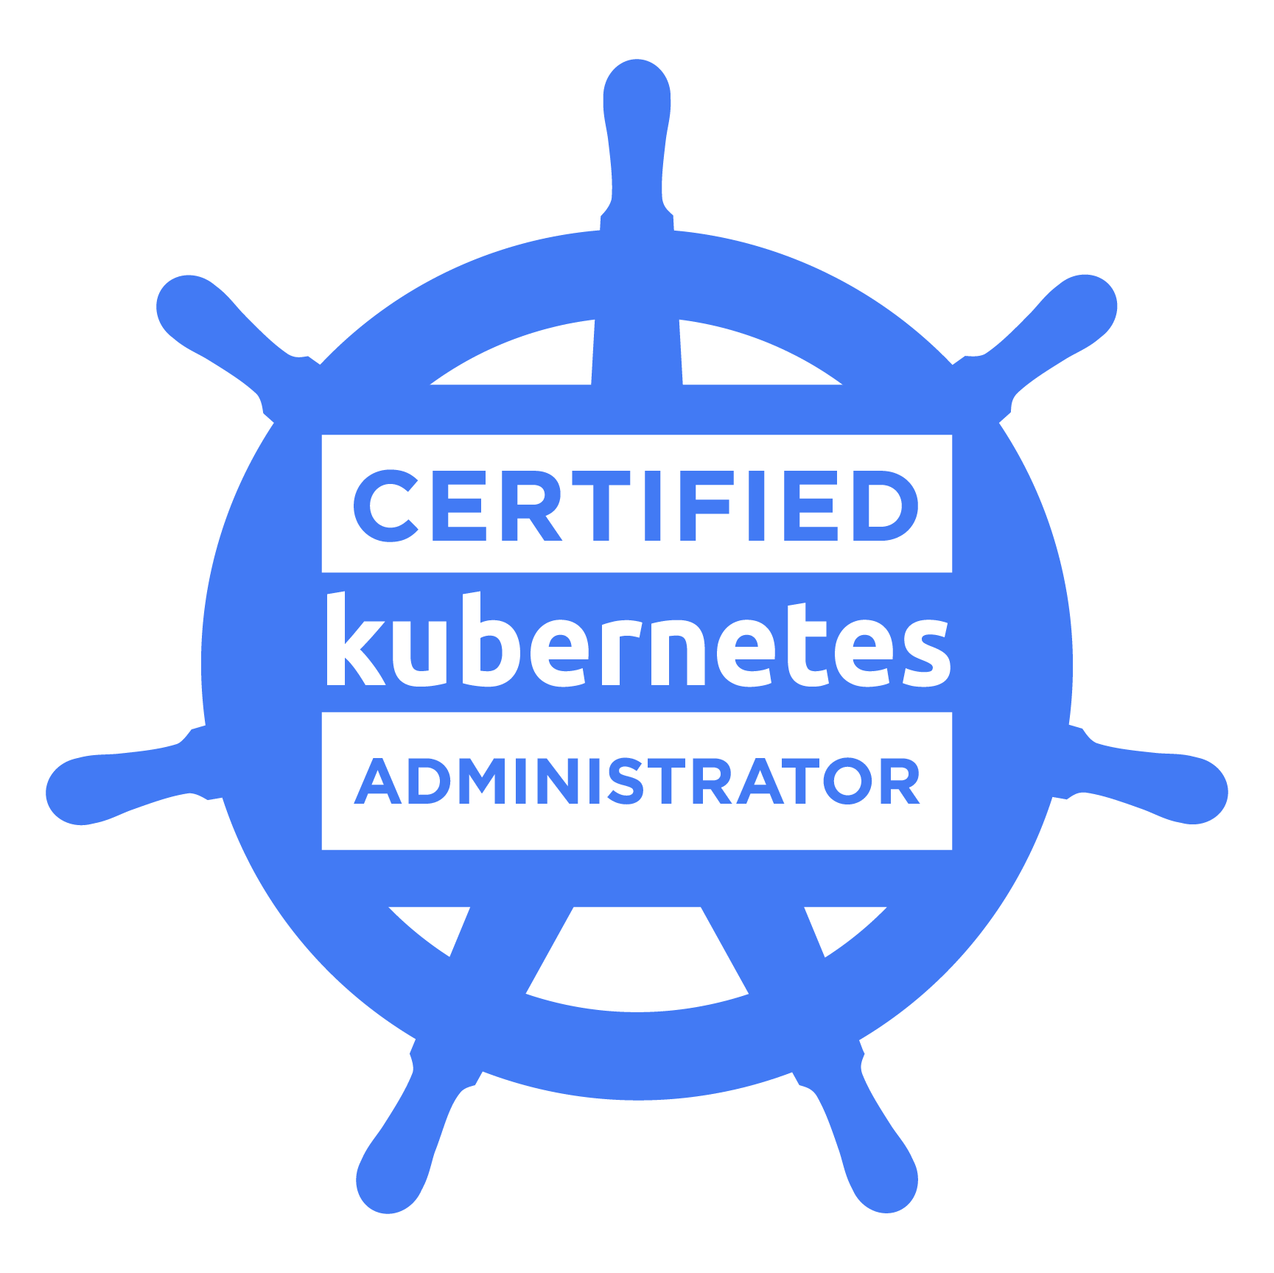
Welcome
This course aims to provide you with knowledge and practical skills necessary to administer Kubernetes clusters and develop Kubernetes applications.
3 sessions:
Day 1 - Deploying applications (basic): Pod, Deployments, Services, Ingress, Configuration…
Day 2 - Deploying applications (advanced): Helm, jsonnet K8s Cluster administration: RBAC, NetworkPolicies…
Day 3 - Building our own cluster Monitoring: Prometheus, Grafana

Slide 4
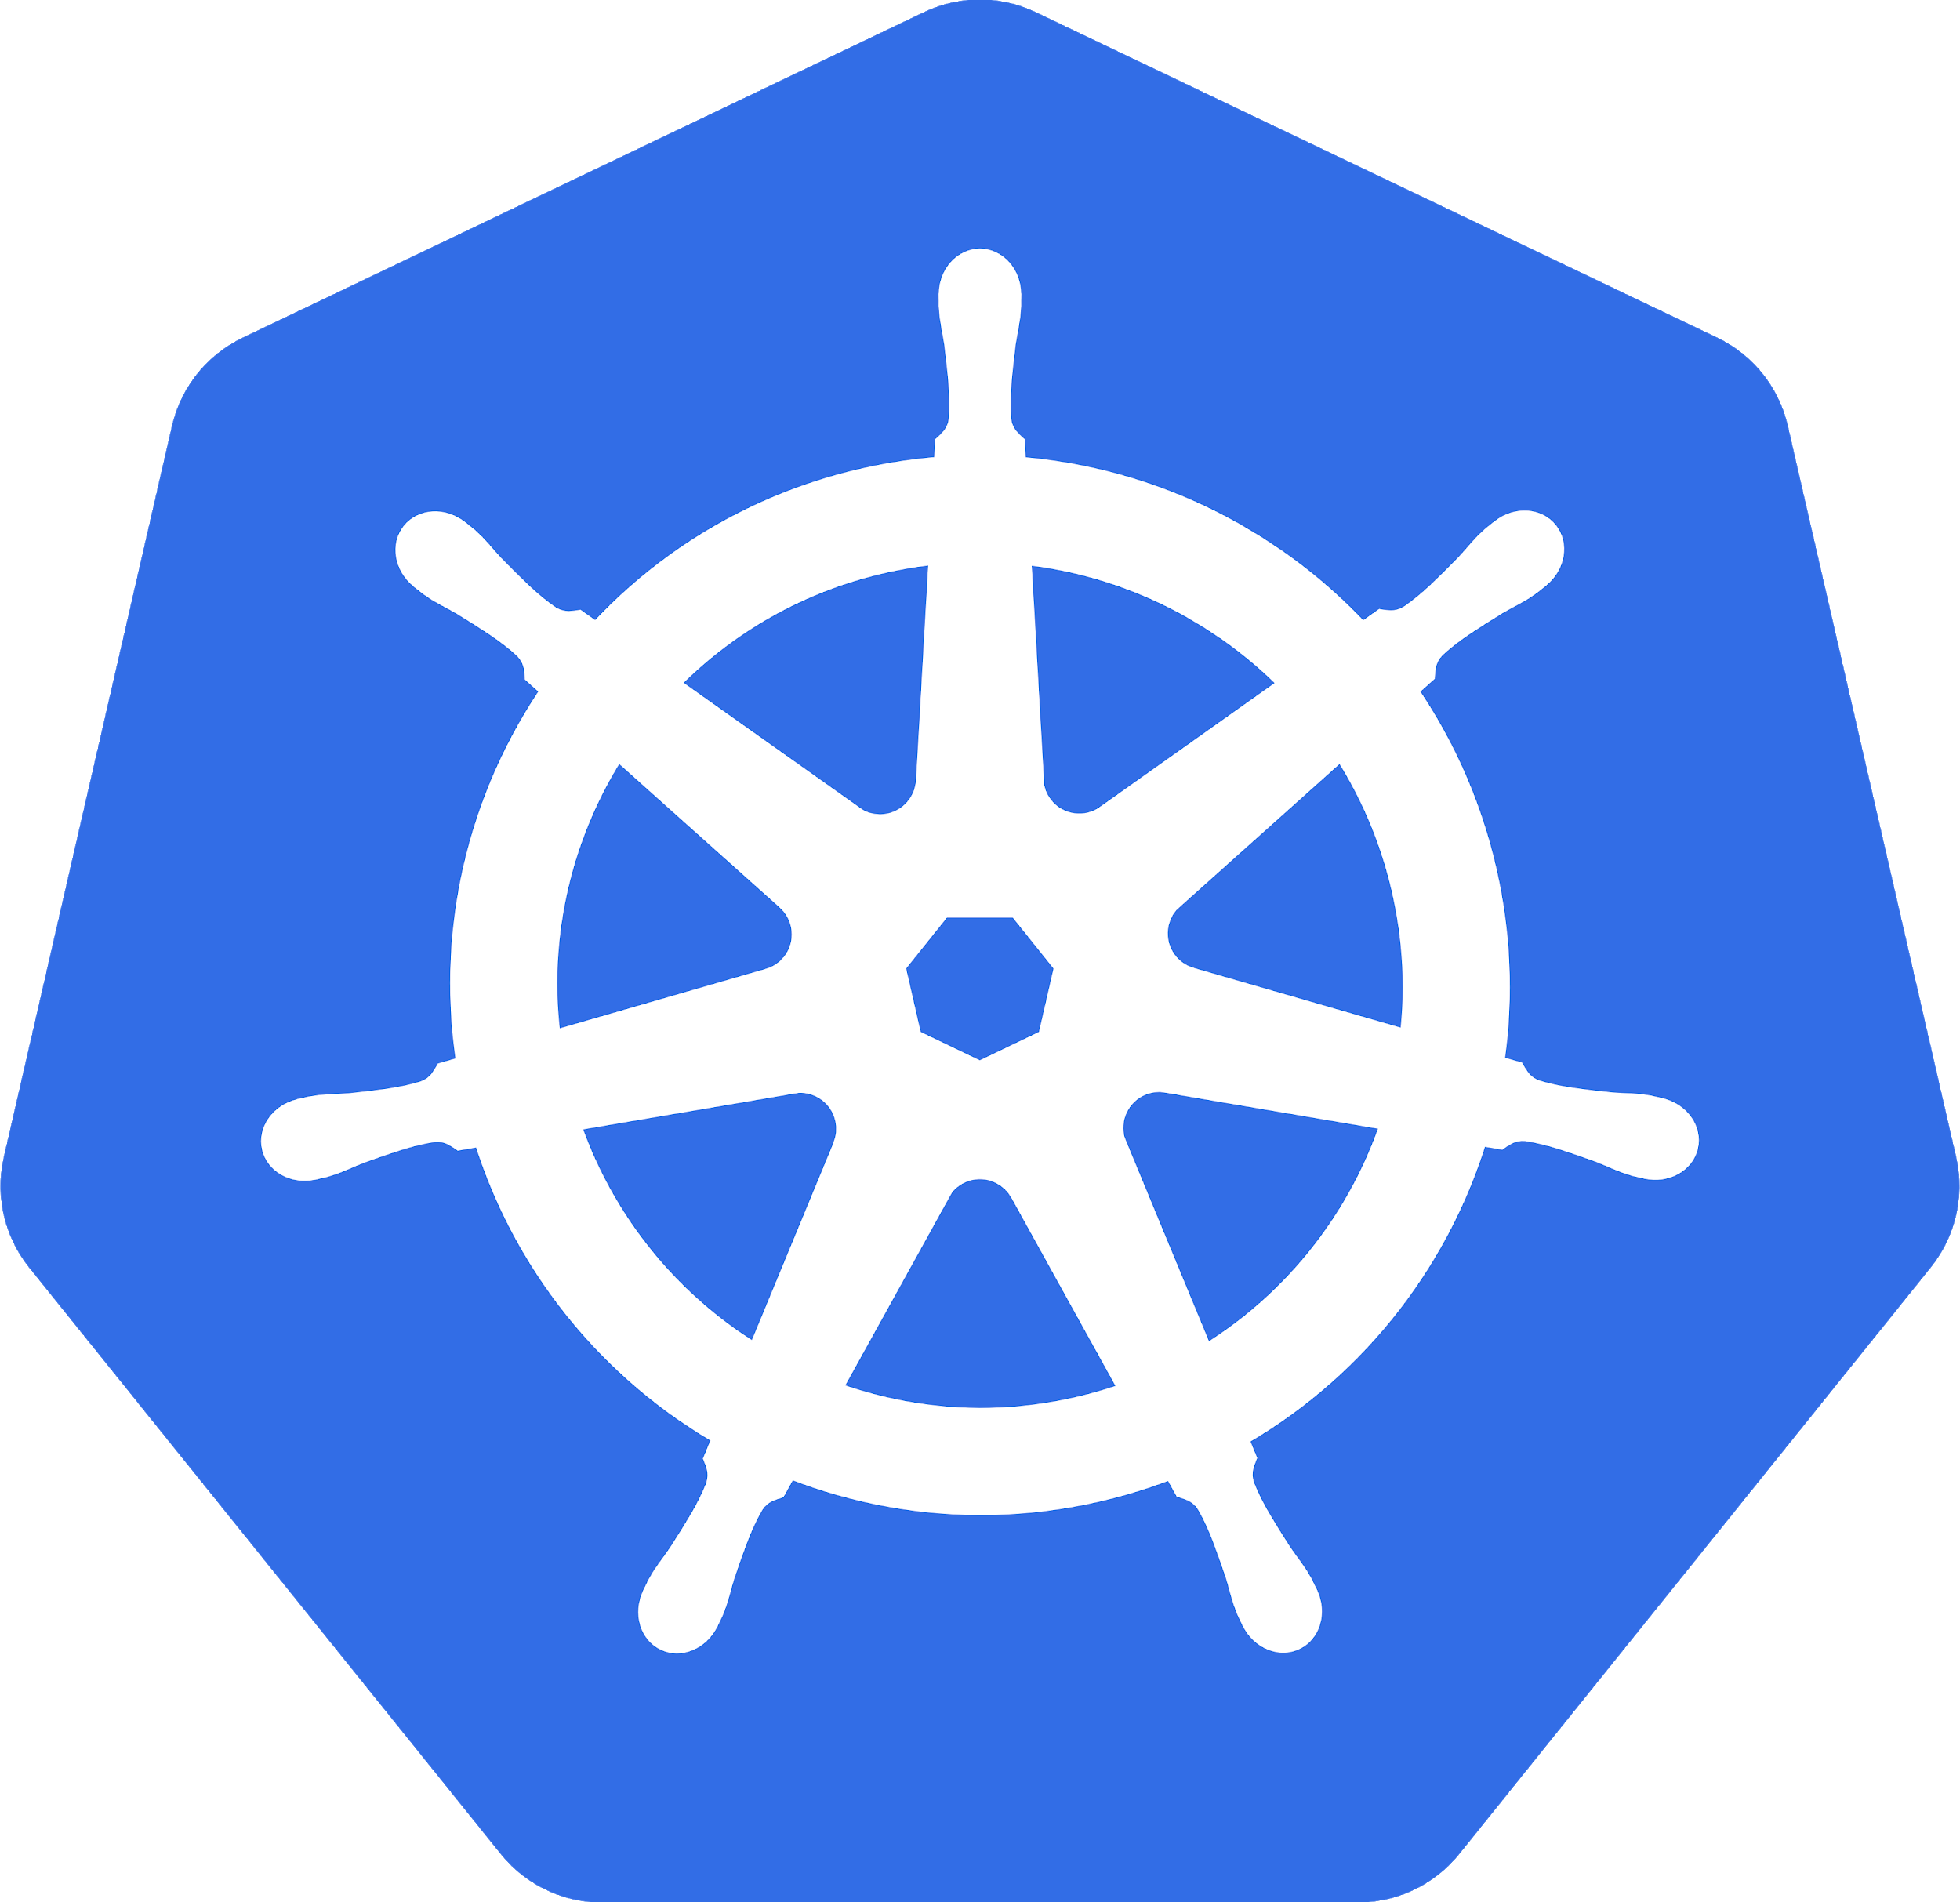
About us
We have a long history of making apps easier to use on any platform: VMs, cloud and containers. Recently we've been developing solutions and tooling for making apps easier to run on Kubernetes.
Several Kubernetes products:
Helm charts (github.com/helm/charts)
Kubeless (github.com/kubeless/kubeless)
Kubeapps (kubeapps.com)
Kubecfg (github.com/ksonnet/kubecfg)
Kubernetes Production Runtime (kubeprod.io)
Stacksmith (bitnami.com/stacksmith)

Slide 5


The lecturers
PhD in Computer Science (Cloud Computing)
CKA & CKAD certified
Top 20 StackOverflow answerers in Kubernetes
Telecommunication engineer
Member of the Kubernetes organization
Active maintainer of the official Helm chart repository
Javier J. Salmeron
Juan Ariza
Course coordinator
We work in the Assets team, where we package production enabled applications in different flavors, such as containers, helm charts or multi-tier cloud deployments.

Slide 6
Welcome
The spoken language of the course is Spanish but all documents and exercises will be in English.
Please provide proactive feedback on whether you are understanding what we are teaching.
All documents, exercises and references will be available in a web application (Google Drive).
Let’s enjoy Kubernetes :)

Slide 7
Share Terminal:
floobits.com/juan131/intel-training-1

Slide 8
Kubernetes Training: Day 1
Introduction
Installation and Setup
Kubectl an the K8s API
Deploying your Apps on K8s
Lunch Break
Services and Ingress
Configuring your Apps on K8s
Persistence

Slide 9
I - Introduction

Slide 10
Introduction
Kubernetes
Kubernetes is an open-source software for automating deployment, scaling, and management of containerized applications.
Kubernetes provides a powerful API to manage distributed applications.
Builds on 15 years of experience at Google.
Open Source and available on GitHub
Apache Software License
Now governed by the Cloud Native Computing Foundation at the Linux Foundation
Several Special Interest Groups (SIG)
Open to everyone
Weekly Hangouts

Slide 11
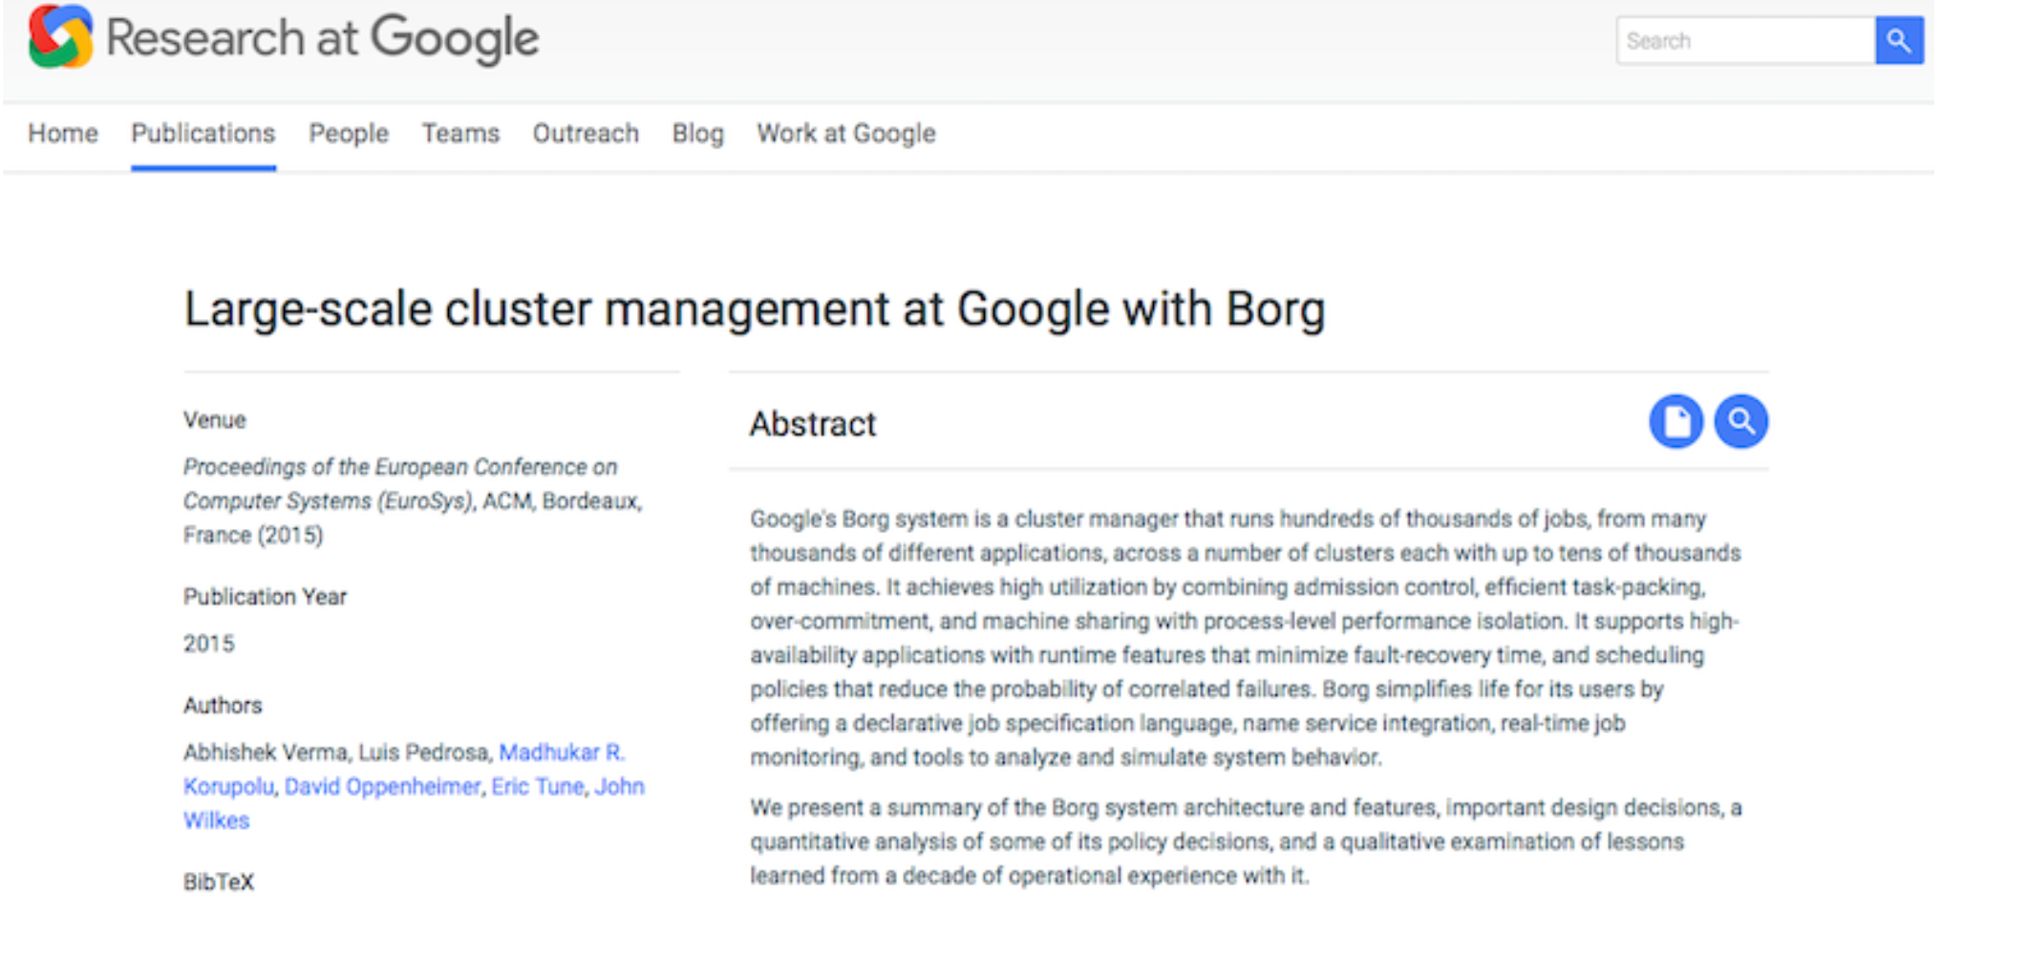
Introduction
Origin of K8s: Borg
Borg was a Google secret for a long time
Orchestration system to manage all Google applications at scale
Finally described publicly in 2015
Paper explains ideas behind Kubernetes

Slide 12
Introduction
Kubernetes Lineage
Google contributed cgroups to the Linux kernel
cgroups and linux namespaces at the heart of containers
Mesos was inspired by discussions with Google when Borg was still secret
Cloud Foundry implements 12 factor apps principles for microservices apps
Omega
OCI
Kubernetes
Cloud
Foundry
Docker
Rkt/appc
Mesos
LXC
cgroups
Borg

Slide 13







Introduction
Kubernetes Lineage
and more...

Slide 14
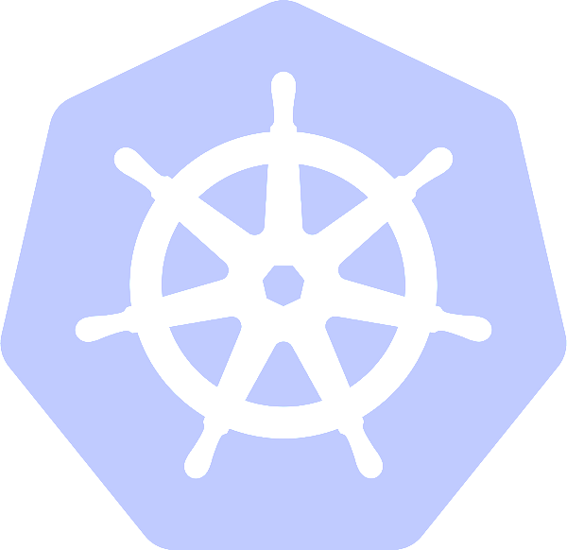
Introduction
Kubernetes Lineage
Open Source in June 2014 (4 years old)
2300+ contributors
+64K commits
Second Biggest Golang project on GitHub (Docker #1)
Google & Red Hat lead contributors (check contribution by company)
23K people on Slack
1 major release every 3 months

Slide 15
Introduction
What is it really?
A cluster manager
A scheduler to place containers in a cluster
Lots of HA features
Geared towards managing apps at scale
Deployed as services on VMs or Bare-metal machines
Kubectl, ajax, etc.
etcd
API Server
Scheduler
Kubelet
Service Proxy
Controller Manager
Kubemetes Architecture

Slide 16

Introduction
A tour of web resources
Some references:
kubernetes.io documentation
Bitnami Documentation
CNCF
GitHub
YouTube Channels
1
2
3
4
5

Slide 17
II - Installation and Setup
Setting up the K8s Sandbox

Slide 18
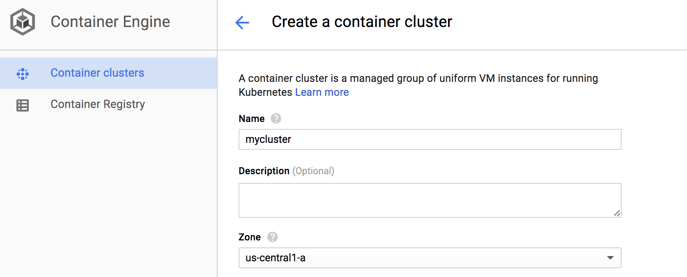
Google Container Engine
GKE
$ gcloud container cluster create my-cluster
Google Cloud tools available:
@ Bitnami: link
Needs an account on Google cloud, create a Kubernetes cluster in the Cloud using GCE instances

Slide 19
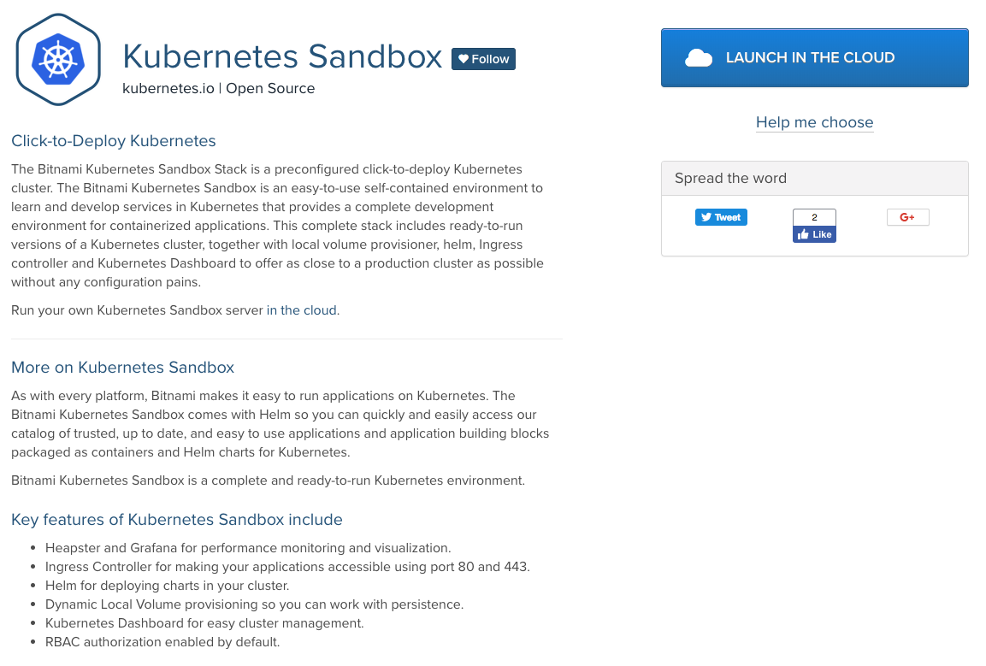
Bitnami Kubernetes Sandbox
Bitnami Kubernetes Sandbox
Preconfigured click-to-deploy K8s cluster. It provides a complete development environment for development applications.
It also includes:
Local Volume provisioner
Helm
Ingress Controller
Kubernetes Dashboard
Docs: https://docs.bitnami.com/aws/infrastructure/kubernetes-sandbox/
AMI: https://bitnami.com/stack/kubernetes-sandbox/cloud/aws

Slide 20
Minikube
Minikube
Install the latest release:
# Linux $ curl -Lo minikube https://storage.googleapis.com/minikube/releases/latest/minikube-linux-amd64 $ chmod +x minikube $ sudo mv minikube /usr/local/bin/ # OS X $ curl -Lo minikube https://storage.googleapis.com/minikube/releases/latest/minikube-darwin-amd64 $ chmod +x minikube $ sudo mv minikube /usr/local/bin/
What is Minikube?
Widely used testing Kubernetes distribution
All components are included in a single Golang executable, localkube
Minikube is open source and available on GitHub.
Start Minikube:
$ minikube start

Slide 21
Minikube
First steps
$ minikube status minikube: Running cluster: Running kubectl: Correctly Configured $ minikube ssh _ _ _ _ ( ) ( ) ___ ___ (_) ___ (_)| |/') _ _ | |_ __ /' _ ` _ `\| |/' _ `\| || , < ( ) ( )| '_`\ /'__`\ | ( ) ( ) || || ( ) || || |\`\ | (_) || |_) )( ___/ (_) (_) (_)(_)(_) (_)(_)(_) (_)`\___/'(_,__/'`\____) $ exit $ minikube logs $ minikube help

Slide 22

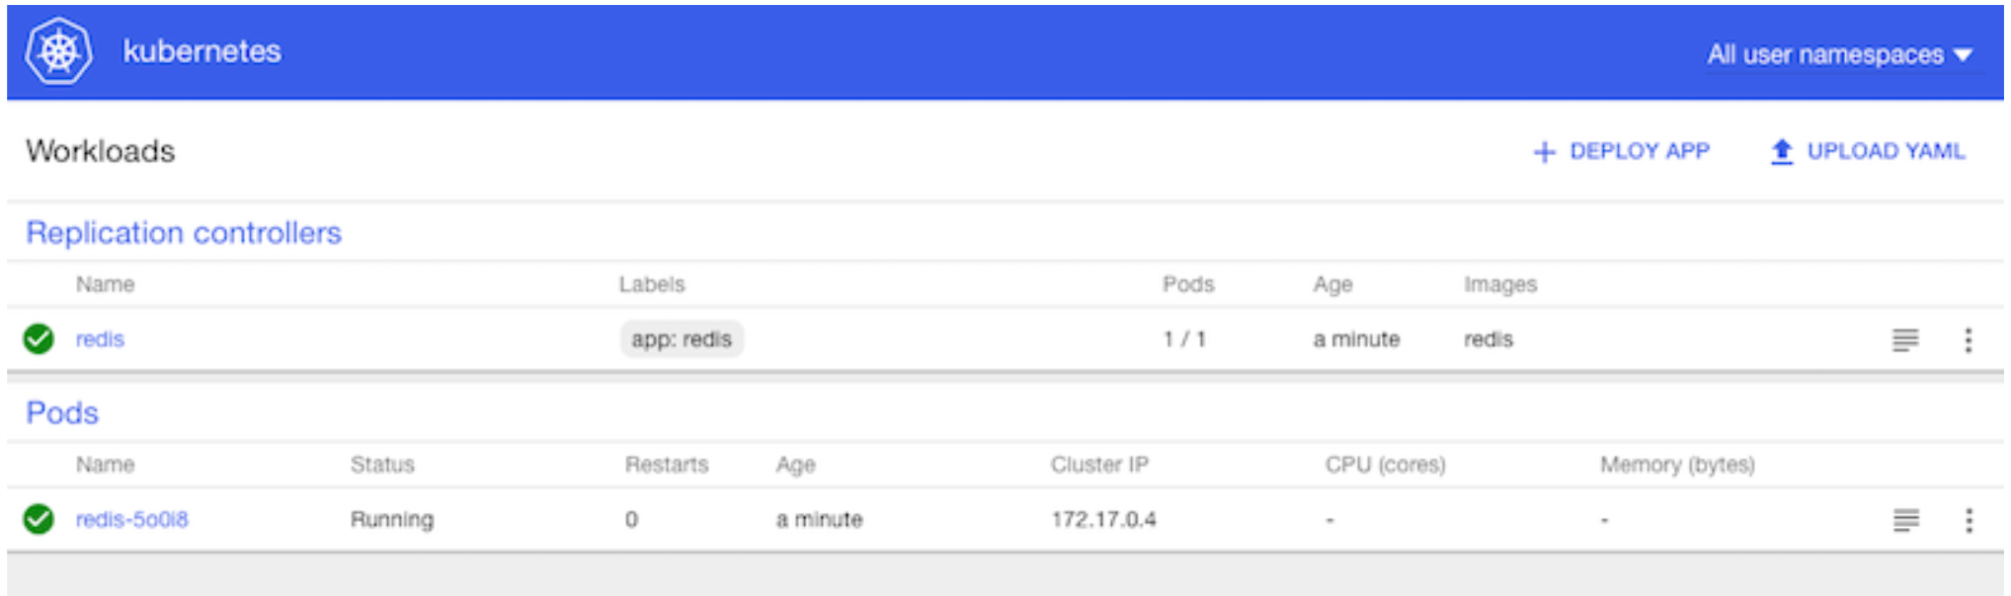
Starting Your First K8s Application via the Dashboard
Access the K8s Dashboard by running the command:
$ minikube dashboard Opening kubernetes dashboard in default browser...
Click on +Create
Specify bitnami/mongodb as a container image
What is happening?
Check the logs

Slide 23
III - Kubectl and the K8s API
kubectl
Introduction to Key Primitives
The Kubernetes API

Slide 24
Using the K8s CLI
Using the Kubernetes CLI
Install Kubectl
# Linux $ curl -LO https://storage.googleapis.com/kubernetes-release/release/$(curl -s https://storage.googleapis.com/kubernetes-release/release/stable.txt)/bin/linux/amd64/kubectl # OS X $ curl -LO https://storage.googleapis.com/kubernetes-release/release/$(curl -s https://storage.googleapis.com/kubernetes-release/release/stable.txt)/bin/darwin/amd64/kubectl $ chmod +x ./kubectl $ sudo mv ./kubectl /usr/local/bin/kubectl
The Dashboard is nice to use but the Kubernetes CLI is extremely powerful.
The k8s CLI is called kubectl

Slide 25
Using the K8s CLI
Using the Kubernetes CLI
Configure kubectl to use Minikube
# Get contexts $ kubectl config get-contexts CURRENT NAME CLUSTER AUTHINFO NAMESPACE * gke_XXXX gke_XXXX gke_XXXX minikube minikube minikube # Use minikube context $ kubectl config use-context minikube $ kubectl config current-context minikube
Docs: Kubectl Context and Configuration

Slide 26
Kubernetes API
Kubernetes API
You can use kubectl to discover the available k8s...
$ kubectl get pods $ kubectl get rs $ kubectl get ns
Learn more about the K8s API on the API Reference Documentation
Or browse around the K8s API...
$ kubectl proxy --port=8080 & $ curl http://127.0.0.1:8080/api { "kind": "APIVersions", "versions": [ "v1" ... $ curl http://127.0.0.1:8080/api/v1 { "kind": "APIResourceList", "groupVersion": "v1", "resources": [ ...

Slide 27
IV - Deploying your Apps on K8s

Slide 28




Application Deployment
A common scenario: web application (frontend) using a database (backend)
Set of VMs running our web app
External Load Balancer
Frontend
Backend
Set of databases
Internal Load Balancer

Slide 29
Application Deployment
A common scenario: web application (frontend) using a database (backend)
However, this is not enough, we want:
Frontend
Backend
Zero downtime
Failover mechanisms
Dynamic scalability
Rolling updates
Automatic deployments
Load Balancing
Easy migration
Monitoring
Role-Based Access Control
Continuous Integration and Delivery

Slide 30






Application Deployment
A common scenario: web application (frontend) using a database (backend)
Deployment
Zero downtime
Failover mechanisms
Dynamic scalability
Configuration Resources
ReplicaSet
Rolling updates
Automatic deployments
Frontend
SVC
Pods
Load Balancing
Easy migration
Monitoring
Role-Based Access Control
Continuous Integration and Delivery
Nginx
Ingress
Deployment
Configuration Resources
ReplicaSet
Backend
SVC
Containers

Slide 31

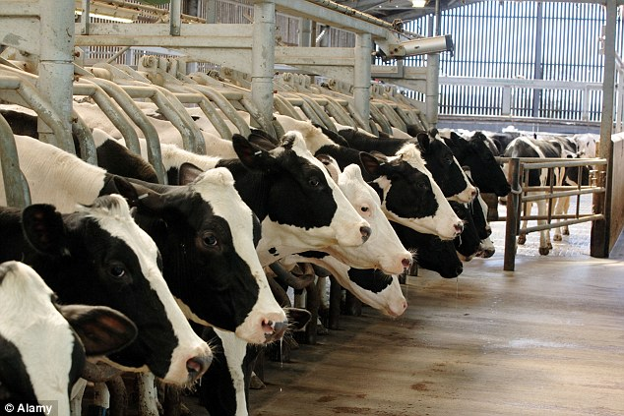
Pets vs Cattle
A different approach for your servers
Pets:
Treated as unique
Typically manually built, managed and updated.
Indispensable, can’t be down
Cattle:
Treated as “just one more”
Automatically built
Designed for failure
Interesting read: The History of Pets vs Cattle and How to Use the Analogy Properly

Slide 32
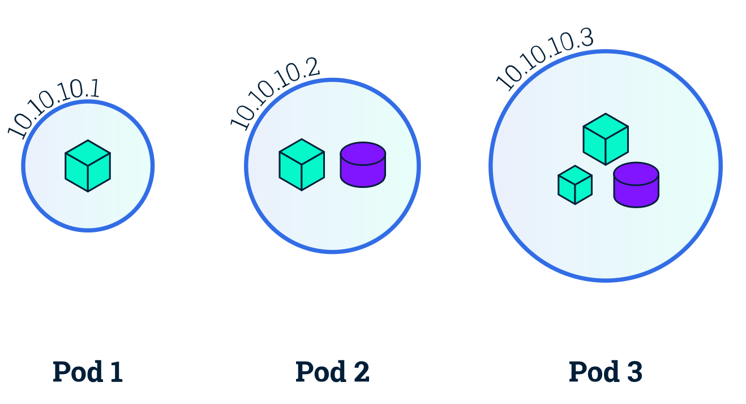
Basic Objects: Pod
Smallest compute unit in Kubernetes. Top level API object to run containers.
Represents a group of colocated containers sharing storage resources and a unique IP.
Pods are EPHEMERAL
Container
Volume

Slide 33
Why pods?
K8s is supposed to manage containers, but pods are the basic building block...
“one process, one container” principle.
No more VMs with dozens of applications. Use a container per process.
But… I need more than one app/process cooperating to run my service
It seems it makes sense to run more than one container sharing storage resources, IP and port space to ensure efficient communication between them.
There are some other reasons why it’s necessary to use pods:
A container can be a Docker container.. But also Rocket or a VM managed by Virlet. Each solution has different requirements/specifications.
K8s needs additional information:
Restart policies
Readiness/Liveness probes
It makes sense to add a new layer of abstraction to define all this information which exceed container duties.

Slide 34
Activity: multi-container or multiple pods
NGINX and PHP-FPM
WP and MariaDB database
MongoDB master and slaves

Slide 35
Describing K8s Object: Yaml skeleton
Describing K8s Object: Yaml skeleton
apiVersion: v1 # required field kind: Pod # required field metadata: # required field name: mongo # required field namespace: default labels: app: mongo ... spec: # required field containers: - image: myImage:latest ... status: hostIP: X.X.X.X phase: Running ...
metadata:
Data that helps uniquely identify the object
Reference: Understanding Kubernetes Objects
spec:
Different on every K8s object.
Describes the characteristics of the K8s object

Slide 36
Pods
Pods
apiVersion: v1 kind: Pod metadata: name: mongo spec: containers: - image: bitnami/mongodb name: mongo
For specifications well documented. See also the user-guide.
Create your fist pod:
$ kubectl create -f mongo.yaml $ kubectl get pods NAME READY STATUS RESTARTS AGE mongo 1/1 Running 0 15s

Slide 37
Labels
Labels
You can define your labels in the objects specifications.
apiVersion: v1 kind: Pod metadata: ... labels: pod-template-hash: "3378155678" run: mongo
Labels are key/value pairs that are attached to objects, such as pods.
You can also add labels on the fly:
Why use labels ?
Because they are a great way to query and select resources. E.g., if you want to force the scheduling of a Pod on a specific node you can use a nodeSelector in a Pod definition. Add specific labels to certain nodes in your cluster and use that labels in the Pod.
$ kubectl label pods mongo foo=bar $ kubectl get pods --show-labels NAME READY STATUS RESTARTS AGE LABELS mongo 1/1 Running 0 11m foo=bar
You can then query by label and display labels in new columns:
$ kubectl get pods -l foo=bar NAME READY STATUS RESTARTS AGE mongo 1/1 Running 0 10m $ kubectl get pods -L foo NAME READY STATUS RESTARTS AGE FOO mongo 1/1 Running 0 5m bar

Slide 38

Basic Objects: ReplicaSet
Zero downtime
Failover mechanisms
Dynamic scalability
A replica set ensures that a specified number of pod “replicas” are running at any one time.
In other words, a replication controller makes sure that a pod or homogeneous set of pods are always up and available.
ReplicaSet
ReplicaSet
ReplicaSet

Slide 39
Basic Objects: ReplicaSet
ReplicaSet
apiVersion: extensions/v1beta1 kind: ReplicaSet metadata: name: nginx namespace: default spec: replicas: 2 selector: matchLabels: app: nginx template: metadata: labels: app: nginx spec: containers: - image: bitnami/nginx name: nginx
Create a ReplicaSet:
For specifications well documented.
$ kubectl create -f rs.yaml
Try to scale it and watch:
$ kubectl scale rs nginx --replicas=5 replicaset "nginx" scaled $ kubectl get pods --watch

Slide 40
Basic Objects: Deployment
Rolling updates
Automatic deployments
Deployment is a higher-level concept that manages ReplicaSets. It allows several management operations like:
Replica management
Pod scaling
Rolling updates
Rollback to a previous version
Clean-up policies
Deployment
ReplicaSet

Slide 41
Deployments
Deployments
apiVersion: extensions/v1beta1 kind: Deployment metadata: name: nginx namespace: default spec: revisionHistoryLimit: 2 strategy: type: RollingUpdate replicas: 2 template: metadata: labels: app: nginx spec: containers: - image: bitnami/nginx name: nginx ports: - name: http containerPort: 8080
Create a Deployment:
For specifications well documented.
$ kubectl create -f deployment.yaml

Slide 42
Scaling and Rolling Update of Deployments
Just like RS, Deployments can be scaled:
$ kubectl scale deployment nginx --replicas=4 deployment "nginx" scaled $ kubectl get deployments NAME DESIRED CURRENT UP-TO-DATE AVAILABLE AGE nginx 4 4 4 1 12m
What if you want to update all your Pods to a specific image version. latest is not a version number...
$ kubectl set image deployment nginx nginx=bitnami/nginx:1.14.0-r49 --all
Watch the RS and the Pods:
$ kubectl get rs --watch NAME DESIRED CURRENT AGE nginx-2529595191 0 0 3m nginx-3771699605 4 4 46s
You can also use:
$ kubectl edit deployment nginx

Slide 43
Deployments Rollback
When you create a deployment you can record your changes in an annotations:
$ kubectl run dokuwiki --image=bitnami/dokuwiki --record $ kubectl get deployments dokuwiki -o yaml
metadata: annotations: deployment.kubernetes.io/revision: "1" kubernetes.io/change-cause: kubectl run dokuwiki --image=bitnami/dokuwiki --record=true
Now do an update and check the status. You will see that the Pod failed. You can now roll back.
$ kubectl set image deployment/dokuwiki dokuwiki=bitnami/dokuwiki:09 --all $ kubectl rollout history deployment/dokuwiki deployments "dokuwiki": REVISION CHANGE-CAUSE 1 kubectl run dokuwiki --image=bitnami/dokuwiki:09 --record=true 2 kubectl set image deployment/dokuwiki dokuwiki=bitnami/dokuwiki:09:09 --all=true $ kubectl get pods NAME READY STATUS RESTARTS AGE dokuwiki-2141819201-tcths 0/1 ImagePullBackOff 0 1m $ kubectl rollout undo deployment/dokuwiki $ kubectl get pods NAME READY STATUS RESTARTS AGE dokuwiki-3378155678-eq5i6 1/1 Running 0 7s

Slide 44
Kubectl Tips and Tricks
$ kubectl config view $ kubectl config use-context $ kubectl annotate $ kubectl label $ kubectl create -f ./<DIR> $ kubectl create -f <URL> $ kubectl edit ... $ kubectl proxy ... $ kubectl exec ... $ kubectl logs ... $ kubectl get pods,svc,deployments $ kubectl --v=99 ... $ kubectl describe ...
A few things to remember about kubectl. And if you don't, check the cheat sheet.

Slide 45
Access the Application with kubectl
To access the containerized app from your local machine you can use a port-forward technique.
Locally you can use a client to connect to the MongoDB running in a container started by Kubernetes:
Accessing an application running in a container via exec is for debugging:
Other useful commands for debugging:
$ kubectl get pods NAME READY STATUS RESTARTS AGE mongo 1/1 Running 0 3m $ kubectl exec -it mongo -- /bin/bash
$ kubectl get pods NAME READY STATUS RESTARTS AGE mongo 1/1 Running 0 3m $ kubectl port-forward mongo 27017:27017 &
$ kubectl describe pod mongo $ kubectl logs mongo
$ mongo >

Slide 46
Hands on: Guestbook - Part I
Create frontend deployment
Access the frontend using kubectl port forward. What do you see?
Create backend deployment. What now?
floobits.com/juan131/k8straining/file/guestbook

Slide 47
V - Services and Ingress
Services to expose your application

Slide 48
Basic Objects: Services
Now that we have a good handle on creating resources, managing and inspecting them with kubectl. The elephant in the room is how do you access your applications?
The answer is Services, another Kubernetes object.
Frontend
SVC
Services are abstractions that define a set of pods that provide a micro-service
They provide a stable virtual endpoint for ephemeral Pods in your cluster. Other services can target them and will be redirected to the endpoints that match the service Pod selection
Backend
SVC
In addition you can use the Service abstraction to expose external resources into your K8s clusters

Slide 49
Services
Implemented via iptables. kube-proxy agent running on all Kubernetes nodes, watches Kubernetes API for new Services and Endpoints being created.
It opens random ports on nodes to listen to traffic to the ClusterIP:Port, and redirects to a random service endpoints (used to be round-robin in userspace implementation).
Backend Pod 1
Labels: app-MyApp
Port: 9376
Backend Pod 2
Labels: app-MyApp
Port: 9376
Backend Pod 3
Labels: app-MyApp
Port: 9376
apiserver
1) Watch Services and Endpoints
5) Proxy to a backend
kube-proxy
4) Redirect to (random) proxy port
2) Open proxy port and set portal rules
iptables
3) Connect to 10.0.0.1:1234
Client

Slide 50
Services Types
ClusterIP
NodePort
LoadBalancer
ClusterIP service type is the default and only provides access internally (except if manually creating an external endpoint).
You can run a kubectl proxy locally to access a ClusterIP service. Great for development.
NodePort type is great for debugging, but you need to open your firewall on that port (NodePort range defined in Cluster configuration). Also used when you want to create your load balancer manually.
LoadBalancer services are currently only implemented on public cloud providers like GKE, AKS or AWS.
Private cloud solutions also may implement this service type if there is a Cloud provider plugin for them in K8s.

Slide 51



Basic Objects: Services
Types:
172.100.3.3:8080
172.100.3.4:8080
172.100.3.5:3306
ClusterIP
NodePort
LoadBalancer
mysql
wordpress
192.168.3.4:3306
192.168.3.3:80
K8s cluster
External
wordpress
wordpress
wordpress
wordpress
40.0.2.4:33311
40.0.2.5:33311
40.0.2.6:33311
40.0.2.7:33311
wordpress
30.3.2.6:80

Slide 52
Services
Services
apiVersion: v1 kind: Service metadata: name: nginx namespace: default spec: type: ClusterIP ports: - name: http port: 80 targetPort: http selector: app: nginx
For specifications well documented.
You can also expose a deployment on the fly. Let's try it:
$ kubectl expose deployment/nginx --port=80 --target-port=8080 --type=NodePort $ kubectl get svc NAME TYPE CLUSTER-IP EXTERNAL-IP PORT(S) AGE nginx NodePort 10.100.56.229 <none> 80:30306/TCP 8s

Slide 53
DNS
DNS
$ kubectl create -f busybox.yaml $ kubectl exec -it busybox -- nslookup nginx.default.svc.cluster.local Server 10.96.0.10 Address: 10.96.0.10:53 Name: nginx.default.svc.cluster.local Address: 10.105.5.251 $ kubectl get svc NAME TYPE CLUSTER-IP EXTERNAL-IP PORT(S) AGE kubernetes ClusterIP 10.96.0.1 <none> 443/TCP 43m nginx NodePort 10.105.5.251 <none> 80:31436/TCP 40m $ kubectl exec -ti busybox -- wget http://nginx Connecting to nginx (10.0.0.112:80) index.html 100% |*******************************| 612 0:00:00 ETA $ kubectl exec -ti busybox -- cat index.html
A DNS service is provided as a Kubernetes add-on in clusters. On GKE, Minikube and K8s Sandbox this DNS service is provided by default.
A service gets registered in DNS and DNS lookup will further direct traffic to one of the matching Pods via the ClusterIP of the service.
Interesting read.

Slide 54
Hands on: Guestbook - Part II
Add services to the backend. What changed?
Add service for the frontend.
floobits.com/juan131/k8straining/file/guestbook

Slide 55


Problem (I)
172.100.3.3:8080
172.100.3.4:80
172.100.3.5:8080
172.100.3.6:80
gamesBlog
sportShop
eLearning
foodBlog
192.168.3.3:80
192.168.3.4:80
192.168.3.5:80
192.168.3.6:80
K8s cluster
External
gamesBlog
sportShop
eLearning
foodBlog
gamesBlog
sportShop
eLearning
foodBlog
40.0.2.4:33311
40.0.2.4:33312
40.0.2.4:33313
40.0.2.4:33314
40.0.2.5:33311
40.0.2.5:33312
40.0.2.5:33313
40.0.2.5:33314
Not viable in production

Slide 56
Problem (II)
172.100.3.3:8080
172.100.3.4:80
172.100.3.5:8080
172.100.3.6:80
gamesBlog
sportShop
eLearning
foodBlog
192.168.3.3:80
192.168.3.4:80
192.168.3.5:80
192.168.3.6:80
K8s cluster
External
gamesBlog
sportShop
eLearning
foodBlog
gamesBlog
sportShop
eLearning
foodBlog
40.0.2.4:33311
40.0.2.4:33312
40.0.2.4:33313
40.0.2.4:33314
40.0.2.5:33311
40.0.2.5:33312
40.0.2.5:33313
40.0.2.5:33314
eLearning
Expensive option
gamesBlog
30.3.2.8:80
foodBlog
30.3.2.6:80
sportShop
30.3.2.9:80
30.3.2.7:80

Slide 57

Solution
172.100.3.3:8080
172.100.3.4:80
172.100.3.5:8080
172.100.3.6:80
172.100.3.8:80
gamesBlog
sportShop
eLearning
foodBlog
192.168.3.3:80
192.168.3.4:80
192.168.3.5:80
192.168.3.6:80
ingress-controller
Rule-based traffic forwarding
192.168.3.7:80
K8s cluster
External
ingress-controller
ingress-controller
40.0.2.4:33313
40.0.2.5:33313
ingress-controller
sportshop.com (30.3.2.8)
30.3.2.8:80

Slide 58
Ingress Controller
Ingress Controller
An Ingress Controller is a proxy (e.g. HAproxy, Nginx) that gets reconfigured based on rules that you create via the Kubernetes API.
NOTE: currently it only supports HTTP and HTTPS traffic.
The Ingress
is collection of rules that allow inbound connections to reach the cluster services
Internet
Internet
Services
Ingress
Services

Slide 59
Ingress API Resource
Ingress objects still an extension API like deployments, replicasets, etc...
A typical Ingress object that you can POST to the API server is:
apiVersion: extensions/v1beta1 kind: Ingress metadata: name: nginx annotations: nginx.ingress.kubernetes.io/affinity: cookie spec: rules: - host: foo.bar.com http: paths: - path: / backend: serviceName: nginx servicePort: 80
NGINX Ingress supported annotations

Slide 60
Ingress Controller
You will need to have an Ingress Controller for the previous rule to take effect. When using the K8s sandbox, an nginx based Ingress Controller is already running.
$ kubectl get deployments --all-namespaces NAMESPACE NAME DESIRED CURRENT READY AGE ... kube-system nginx-ingress-controller 1 1 1 1h ... $ kubectl get deployment nginx-ingress-controller -n kube-system -o yaml

Slide 61
Hands on: Guestbook - Part III
Create an Ingress rule to allow inbound traffic to your Guestbook site.

Slide 62
VI - Configuring your Apps on K8s

Slide 63
Configuring your apps via env. vars
Configuring your apps via env. vars
Take a look to the different configurations supported on the Bitnami MySQL Docker Image...
As you can check, we can use the env. variable ALLOW_EMPTY_PASSWORD to configure MySQL to disable authentication. Use it on a Pod:
Using environment variables is one of the most extended methods to configure containerized apps.
apiVersion: v1 kind: Pod metadata: name: mysql spec: containers: - name: mysql image: bitnami/mysql env: - name: ALLOW_EMPTY_PASSWORD value: "yes"
No password needed as you can check:
$ kubectl create -f mysql.yaml $ kubectl exec -it mysql -- mysql -h 127.0.0.1

Slide 64
Using ConfigMaps
ConfigMaps
You can create, get, delete configMaps.
$ kubectl get cm $ kubectl create cm --help $ kubectl create configmap mysql --from-literal=replication-mode=master --from-literal=replication-user=master
ConfigMaps provide a way to inject configuration data into pods so it is consumed by our containerised applications.
You can use them in a Pod:
apiVersion: v1 kind: Pod metadata: name: mysql spec: containers: - name: mysql image: bitnami/mysql env: - name: ALLOW_EMPTY_PASSWORD value: "yes" - name: MYSQL_REPLICATION_MODE valueFrom: configMapKeyRef: name: mysql key: replication-mode - name: MYSQL_REPLICATION_USER valueFrom: configMapKeyRef: name: mysql key: replication-user
Note: In future sessions, we’ll study different ways to use ConfigMap to inject configuration data

Slide 65
Using Secrets
Secrets
You can create, get, delete secrets.
$ kubectl get secrets $ kubectl create secret generic --help $ kubectl create secret generic mysql --from-literal=password=root
In order to pass sensitive information to the applications we deploy, we used secrets.
Common sensitive data:
passwords, ssh keys, Oauth tokens, etc.
You can use them in a Pod:
apiVersion: v1 kind: Pod metadata: name: mysql spec: containers: - name: mysql image: bitnami/mysql env: - name: MYSQL_ROOT_PASSWORD valueFrom: secretKeyRef: name: mysql key: password
Is it secure?
NOT ENCRYPTED
$ kubectl get secret mysql -o json | jq -r '.data.password' | base64 --decode

Slide 66
Namespaces
Namespaces
Common commands:
$ kubectl get ns $ kubectl create ns myns $ kubectl get ns/myns -o yaml $ kubectl delete ns/myns
Namespaces are intended to isolate multiple groups/teams and give them access to a set of resources.
Each namespace can have quota
You can define RBAC policies in namespaces
Create a Pod in myns:
$ cat << 'EOF' >> mongo.yaml > apiVersion: v1 > kind: Pod > metadata: > name: mongo > namespace: myns > spec: > containers: > - image: bitnami/mongodb > name: mongo > EOF $ kubectl create -f mongo.yaml

Slide 67
VII - Persistence

Slide 68
Persistence
Some applications require persistent data
Data lost!
Pods are ephemeral
Volume
Solution: use volumes to provide persistent storage
Data safe!

Slide 69
Adding persistence to a Pod
apiVersion: v1 kind: Pod metadata: name: example spec: containers: - image: busybox name: busy volumeMounts: - mountPath: /busy name: test volumes: - name: test <???????>
This depends on the type of volume
hostPath: local node filesystem
gcePersistentDisk: Google Compute Engine storage
gcePersistentDisk: pdName: my-data-disk fsType: ext4
hostPath: path: /data
awsElasticBlockStore: AWS EBS storage
gitRepo: clone a git repository
awsElasticBlockStore: volumeID: vol-0a07f3e37b fsType: ext4
gitRepo: repository: "git@github.com:my/repo.git" revision: "22f1d8406d464b0c087407253775"
configMap: kubernetes config map
secret: kubernetes secret
secret: secretName: mysecret
configMap: name: log-config items: - key: log_level path: log_level

Slide 70
Example: sharing volumes between containers
apiVersion: v1 kind: Pod metadata: name: example spec: containers: - name: busy image: busybox volumeMounts: - mountPath: /busy name: test name: busy - name: box image: busybox volumeMounts: - mountPath: /box name: test volumes: - name: test emptyDir: {}
emptyDir: persistent storage only until pod is deleted

Slide 71
In the developer’s shoes
Developer
So far it is too specific
apiVersion: v1 kind: Pod metadata: name: example containers: - image: busybox volumeMounts: - mountPath: /busy name: test name: busy volumes: - name: test emptyDir: {}
awsElasticBlockStore: volumeID: vol-0a07f3e37b fsType: ext4
hostPath: path: /data
gcePersistentDisk: pdName: my-data-disk fsType: ext4
Why would I need to know these low-level details?
I would need to know set of requirements:
Size
Read only or Read or Write
Storage backend (only if it is important)
etc...
- name: test Volume with 10 GB Read and write
Can the cluster get me a volume given a set of requirements?

Slide 72
PersistentVolumeClaims
Abstraction to request volumes to the cluster
Developer
apiVersion: v1 kind: Pod metadata: name: example containers: - image: busybox volumeMounts: - mountPath: /busy name: test name: busy volumes: - name: test Volume with 10 GB Read and write
kind: PersistentVolumeClaim apiVersion: v1 metadata: name: myclaim spec: accessModes: - ReadWriteOnce resources: requests: storage: 10Gi
ReadWriteOnce
ReadOnlyMany
ReadWriteMany
Once created, use it in your pod
- name: test persistentVolumeClaim: claimName: myclaim

Slide 73
In the cluster administrator’s shoes
Administrator
Before we knew where the volumes came from
hostPath: path: /data
gcePersistentDisk: pdName: my-data-disk fsType: ext4
awsElasticBlockStore: volumeID: vol-0a07f3e37b fsType: ext4
gitRepo: repository: "git@github.com:my/repo.git" revision: "22f1d8406d464b0c087407253775"
With PersistentVolumeClaims:
What will the cluster use?
How does it know which storage resources are available?
We need another object that represents available storage to use

Slide 74
PersistentVolume
Administrator
Object that represents available volumes in the cluster
apiVersion: "v1" kind: "PersistentVolume" metadata: name: "pv0001" spec: capacity: storage: "10Gi" accessModes: - "ReadWriteOnce" gcePersistentDisk: fsType: "ext4" pdName: "pd-disk-1"
The volume’s storage backend details are defined here
When a PersistentVolumeClaim is created, it will search in the pool of PersistentVolumes

Slide 75
Volume workflow: Static method (I)
Tip: Labels for organization
apiVersion: "v1" kind: "PersistentVolume" metadata: name: "pv0001" labels: type: local spec: capacity: storage: "10Gi" accessModes: - "ReadWriteOnce" hostpath: path: "/mnt/data"
apiVersion: "v1" kind: "PersistentVolume" metadata: name: "pv0002" labels: type: gce spec: capacity: storage: "30Gi" accessModes: - "ReadWriteOnce" gcePersistentDisk: fsType: "ext4" pdName: "pd-disk-1"
apiVersion: "v1" kind: "PersistentVolume" metadata: name: "pv0003" labels: type: ebs spec: capacity: storage: "2Gi" accessModes: - "ReadWriteOnce" awsElasticBlockStore: volumeID: vol-0a07f3e37b fsType: ext4
Create PersistentVolumes
Administrator

Slide 76
Volume workflow: Static method (II)
Pool of PersistentVolumes
kind: PersistentVolumeClaim apiVersion: v1 metadata: name: myclaim1 spec: accessModes: - ReadWriteOnce resources: requests: storage: 10Gi
"pv0001" type: local "10Gi" "ReadWriteOnce"
BOUND
"pv0002" type: gce "30Gi" "ReadWriteOnce"
Searching...
"pv0003" type: ebs "2Gi" "ReadWriteOnce"
Developer

Slide 77
Volume workflow: Static method (III)
kind: PersistentVolumeClaim apiVersion: v1 metadata: name: myclaim2 spec: accessModes: - ReadWriteOnce resources: requests: storage: 20Gi <I WANT A GCE VOLUME>
Pool of PersistentVolumes
"pv0001" type: local "10Gi" "ReadWriteOnce"
BOUND
name: myclaim1
BOUND
"pv0002" type: gce "30Gi" "ReadWriteOnce"
SRE Handbook:
Rule:
Use label “gce” for GCE storage
selector: matchLabels: type: "gce"
"pv0003" type: ebs "2Gi" "ReadWriteOnce"
Administrator
Developer

Slide 78
Volume workflow: Static method (IV)
Pool of PersistentVolumes
kind: PersistentVolumeClaim apiVersion: v1 metadata: name: myclaim3 spec: accessModes: - ReadWriteOnce resources: requests: storage: 100Gi
"pv0001" type: local "10Gi" "ReadWriteOnce"
BOUND
name: myclaim1
BOUND
"pv0002" type: gce "30Gi" "ReadWriteOnce"
name: myclaim2
"pv0003" type: ebs "2Gi" "ReadWriteOnce"
No volume available
Developer

Slide 79
Volume workflow: Dynamic method (I)
Pool of PersistentVolumes
Storage Provisioner (default)
Local
Pods that are able to create PersistentVolumes on demand
Storage Provisioner
gce-pd
Only in GCE
Administrator

Slide 80
Volume workflow: Dynamic method (II)
Pool of PersistentVolumes
Storage Provisioner (default)
kind: PersistentVolumeClaim apiVersion: v1 metadata: name: myclaim spec: accessModes: - ReadWriteOnce resources: requests: storage: 30Gi
"pv0001" "30Gi" "ReadWriteOnce"
Local
BOUND
Storage Provisioner
gce-pd
Only in GCE
Developer

Slide 81
Volume workflow: Dynamic method (III)
Pool of PersistentVolumes
kind: PersistentVolumeClaim apiVersion: v1 metadata: name: myclaim2 spec: accessModes: - ReadWriteOnce resources: requests: storage: 30Gi storageClass: gce-pd
Storage Provisioner (default)
"pv0001" "30Gi" "ReadWriteOnce"
Local
BOUND
BOUND
name: myclaim1
Storage Provisioner
gce-pd
"pv0002" “gcePersistentDisk” "30Gi" "ReadWriteOnce"
Only in GCE
Developer

Slide 82
Hands on!
Demo 1
Create a PersistentVolumeClaim for MariaDB and demonstrate the persistence.

Slide 83
Use Case: Canary Deployments
Labels, Services and Deployments are key to Canary deployments scenarios.
Typical Steps:
Create two deployments
Add labels that differentiate the canary plus a common label
Create a service that selects all Pods from the two deployments
selector: app: guestbook <CHOOSE YOUR LABEL>

Slide 84
Activity: WordPress with MariaDB
Create a namespace
Use deployments to create WP+MariaDB
You will need to set some env. variables
Use configMap to configure the apps
Use secrets for sensitive data
Create services and an Ingress to access WordPress
Canary Deployment
Consider WP 4.9.7 the stable version
Use WP 4.9.8 for the canary
Add Liveness & Readiness Probes on your containers.
Add persistence to MariaDB using a PVC
Could the Ingress handle my TLS certificates?
Useful link: Available env. variables on WP Image

